Slide 1
2025 Data Mining
HW2

Slide 2
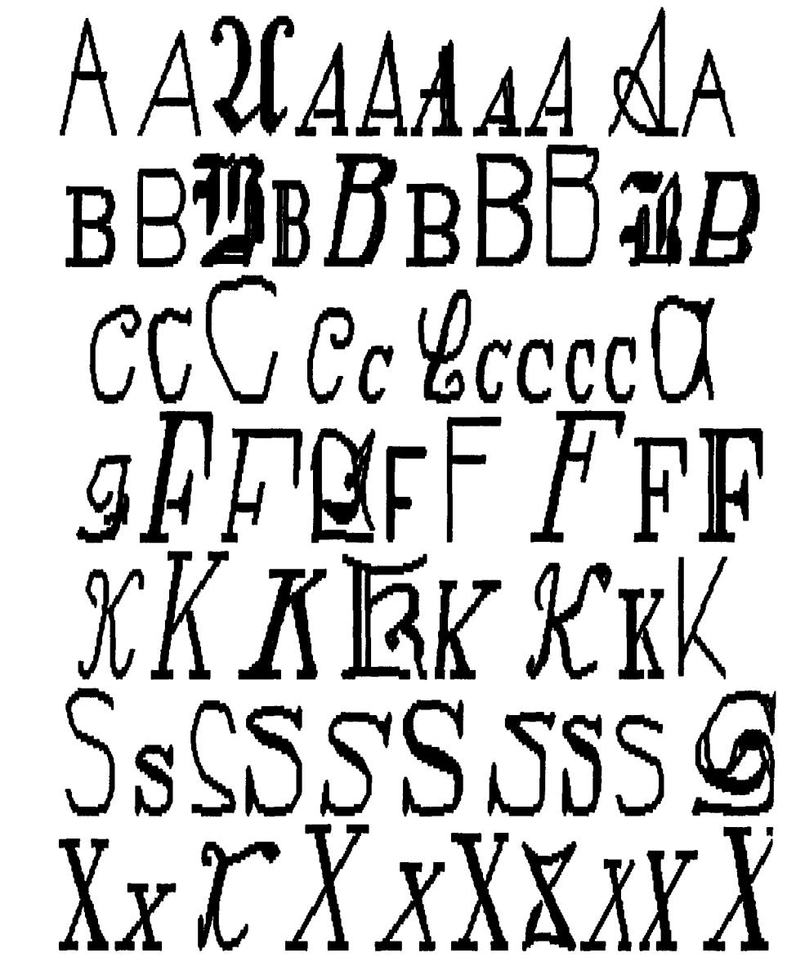
Task introduction
Anomaly Detection
TA use the Letter Image Data features and select 6 letters to form the training set, and randomly add some other 4 letters as outliers in testing set.
Implement machine/deep learning model to do anomaly detection.
All package is available (sklearn, keras, pytorch etc.).
Do not use any pretrained model & Do not use any extra data for training, but it is acceptable to use such data for validation purposes.
Requirement
Upload your submission to Kaggle
Submit a report and your source code to E3
Deadine is 4/22(Tue.) 23:59, no late submission

Slide 3
Dataset
UCI Letter Image Recognition Data Set.
training.csv
Randomly sample 6 letters(each label is 700) from Letter Image Recognition Data Set.
link
test_X.csv
Randomly sample 600 from previous letters, and randomly select 400 other letters.
Please use the features to assign weight values to indicate whether each letter is an outlier or not.
link

Slide 4
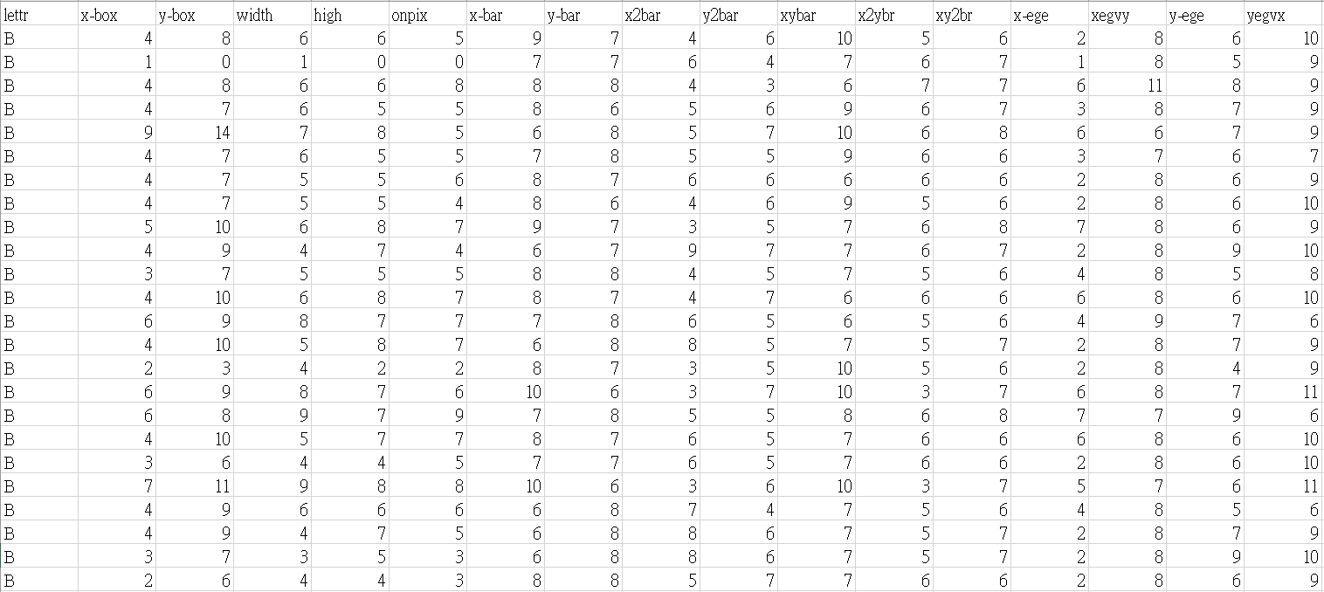
Training Data
All features are given.

Slide 5
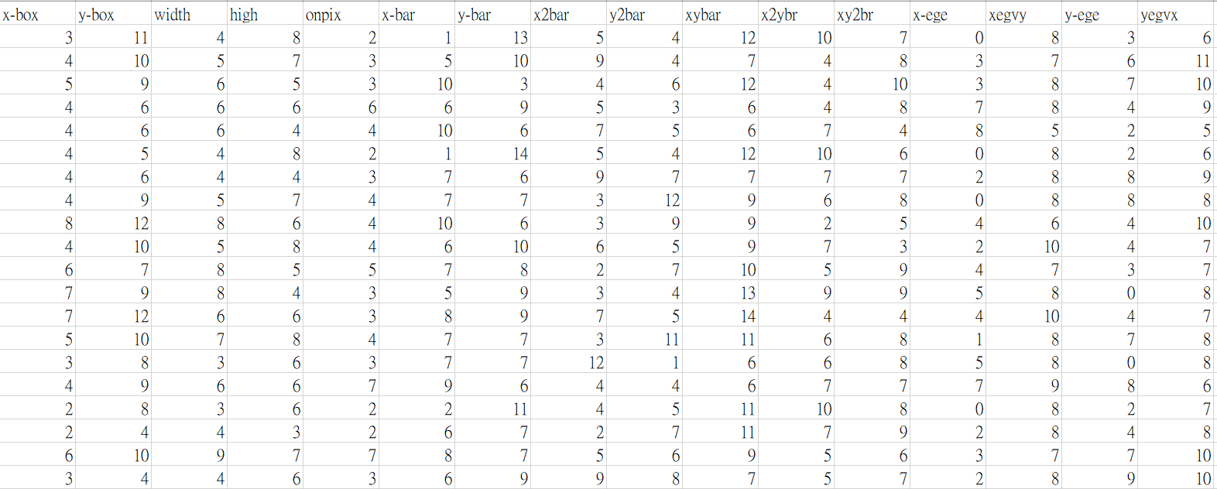
Testing Data
No letter attribute, use it to predict it is outlier or not!

Slide 6
Attributes Description
lettr capital letter (26 values from A to Z)
x-box horizontal position of box (integer)
y-box vertical position of box (integer)
width width of box (integer)
high height of box (integer)
onpix total # on pixels (integer)
x-bar mean x of on pixels in box (integer)
y-bar mean y of on pixels in box (integer)

Slide 7
Attributes Description
x2bar mean x variance (integer)
y2bar mean y variance (integer)
xybar mean x y correlation (integer)
x2ybr mean of x * x * y (integer)
xy2br mean of x * y * y (integer)
x-ege mean edge count left to right (integer)
xegvy correlation of x-ege with y (integer)
y-ege mean edge count bottom to top (integer)
yegvx correlation of y-ege with x (integer)

Slide 8
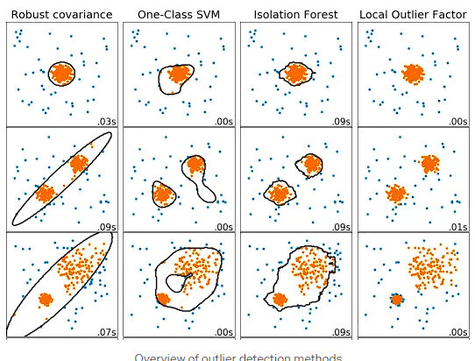
Method 1 - SVM
Use OneClass SVM to learn a decision boundary.
Find the suitable kernel space and parameters to fit the data.
Convert the result of classification to the self-defined value.

Slide 9
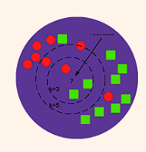
Method 2 - KNN
Assume that there are n clusters in training data.
Assume that n is a small value
Using K-means to calculate the n centroids of training data. Then use these n centroids to cluster the testing data.
In the same cluster, the distance between inliers to centroid must smaller than the distance between outliers to centroid.
We can take the distance to centroids as the weight value for prediction.

Slide 10
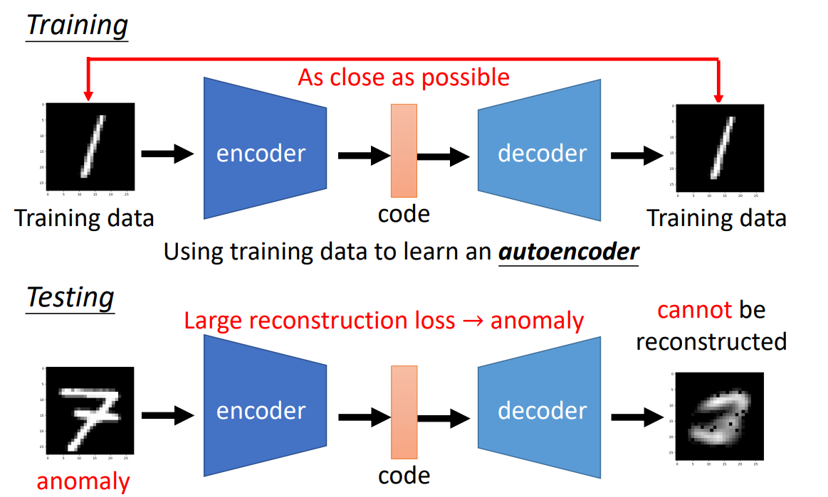
Method 3 - Autoencoder
Using training data to train a AE or VAE
Because the outliers cannot be reconstructed well, the MSE of outliers must greater than inliers.
We can take the reconstruction loss as the weight value for prediction.

Slide 11





Methed 4 - Any reasonable way you can think
The key point is to make objects within the same group as similar as possible, and keeping those in different groups to be as dissimilar as possible.
Let me think…
No restrictions?
Ah, ha!
Compactness & Separation
HW2? No way!

Slide 12
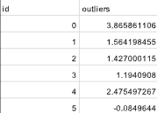
Kaggle Submission
Kaggle link
Display team name : <student ID>
team name error : -5%
Submission format
A 1001*2 .csv file, index start from 0. Outliers are any weight values that you define.(MSE, F1Loss, distance etc.)
Column name must be id and outliers.
sample submission
There are one simple baseline and one strong baseline, beat them to get higher score.

Slide 13
Kaggle Submission
The scoring metric is auc score.
You can submit at most 5 times each day.
You can choose 3 of the submissions to be considered for the private leaderboard, or will otherwise default to the best public scoring submissions.
You can only view your private leaderboard score after the competition has ended.
Public leaderboard is calculated with 60% of the test data, and private leaderboard is calculated with other 40% of the test data, so the final standings may be different.
Please tune your model parameters using your own validation set instead of adjusting parameters based on the public leaderboard. Otherwise, it's easy to overfit, leading to poor performance on the private leaderboard.

Slide 14
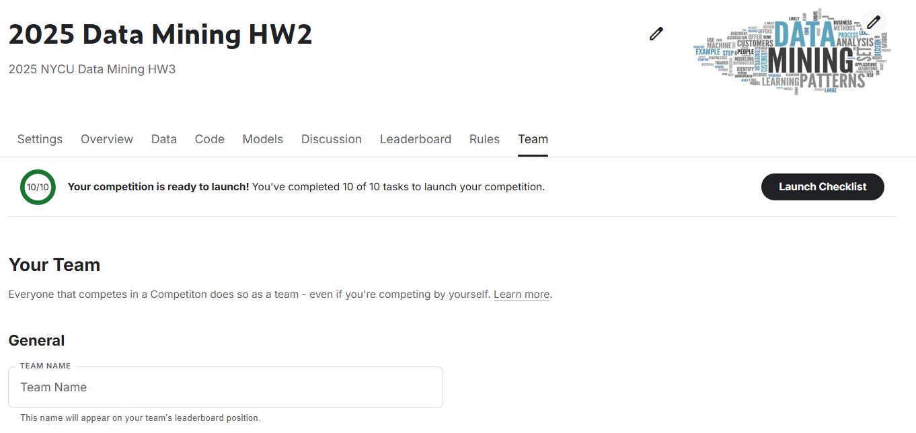
Change your team name
Remember to change the team name to <student ID>, or there will be a deduction of 5 points for HW2.

Slide 15
Report Submission
Answer the following 3 questions:
Explain your implementation which get the best performance in detail.
Explain the rationale for using auc score instead of F1 score for binary classification in this homework.
Discuss the difference between semi-supervised learning and unsupervised learning.
Please answer the questions in detail to receive full points for each question.

Slide 16
Grading policy
Kaggle (70%)
30% based on the public leaderboard score and 70% based on the private leaderboard score
Leaderboard score consists of basic score and ranking score
Basic score: Over strong baseline : 55 Over simple bassline : 40 Under simple baseline : 25
Ranking score: 15-(15/N)*(ranking-1), N=numbers of people
Report (30%)
10% for each quesiton

Slide 17
E3 Submission
Submit your source code and report to E3 before 4/22(Tue.) 23:59.
No late submission !
Follow the submission format or there will be a deduction of 5 points for HW2 !
Format
source code : HW2_<student ID>.py or HW2_<student ID>.ipynb
report : HW2_<student ID>.pdf
If you have any question about HW2, please feel free to contact with TA: CHENG-XIN SONG
through email chengxin0913.cs12@nycu.edu.tw

Slide 18
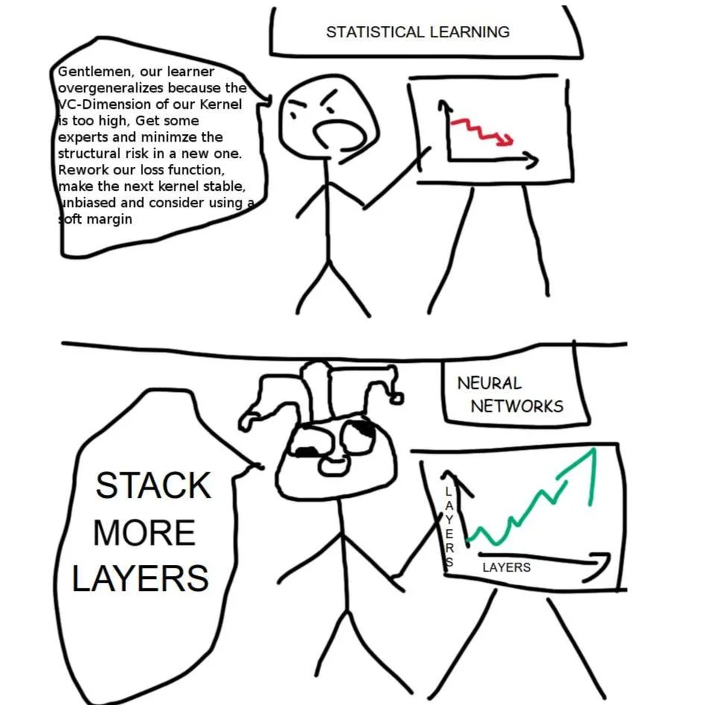
Take Easy

